Slide 1
CSE 322
Construction of Reduced Grammars and Elimination of null and unit productions

Slide 2
How to “simplify” CFGs?
Notes:
Cpt S 317: Spring 2009
School of EECS, WSU

Slide 3
Three ways to simplify/clean a CFG
(clean)
Eliminate useless symbols
(simplify)
Eliminate ε-productions
Eliminate unit productions
A => ε
A => B
Notes:
Cpt S 317: Spring 2009
School of EECS, WSU

Slide 4
Eliminating useless symbols
Notes:
Cpt S 317: Spring 2009
School of EECS, WSU

Slide 5
Eliminating useless symbols
A symbol X is reachable if there exists:
  S ➔* α X β
A symbol X is generating if there exists:
  X ➔* w,
    for some w ∈ T*
For a symbol X to be “useful”, it has to be both reachable and generating
    S ➔* α X β ➔* w’, for some w’ ∈ T*
reachable
generating
Notes:
Cpt S 317: Spring 2009
School of EECS, WSU

Slide 6
Algorithm to detect useless symbols
First, eliminate all symbols that are not generating
Next, eliminate all symbols that are not reachable
Is the order of these steps important,
or can we switch?
Notes:
Cpt S 317: Spring 2009
School of EECS, WSU

Slide 7
Example: Useless symbols
S➔AB | a
A➔ b
A, S are generating
B is not generating (and therefore B is useless)
==> Eliminating B… (i.e., remove all productions that involve B)
  S➔ a
  A ➔ b
Now, A is not reachable and therefore is useless
Simplified G:
  S ➔ a
What would happen if you reverse the order:
i.e., test reachability before generating?
Will fail to remove: A ➔ b
Notes:
Cpt S 317: Spring 2009
School of EECS, WSU

Slide 8
Algorithm to find all generating symbols
X ➔* w
Given: G=(V,T,P,S)
Basis:
  Every symbol in T is obviously generating.
Induction:
  Suppose for a production A➔ α, where α is generating
  Then, A is also generating
Notes:
Cpt S 317: Spring 2009
School of EECS, WSU

Slide 9
Algorithm to find all reachable symbols
S ➔* α X β
Given: G=(V,T,P,S)
Basis:
  S is obviously reachable (from itself)
Induction:
  Suppose for a production A➔ α₁ α₂… α_{k}, where A is reachable
  Then, all symbols on the right hand side, {α₁, α₂ ,… α_{k}} are also reachable.
Notes:
Cpt S 317: Spring 2009
School of EECS, WSU

Slide 10
Practice Questions
Q#1: T → aaB | abA | aaT
A → aA
B → ab | b
C → ad
Eliminate the Useless symbols in given grammar

Slide 11
Solution of Ex#1
In the above example, the variable 'C' will never occur in the derivation of any string, so the production C → ad is useless. So we will eliminate it, and the other productions are written in such a way that variable C can never reach from the starting variable 'T'.
Production A → aA is also useless because there is no way to terminate it. If it never terminates, then it can never produce a string. Hence this production can never take part in any derivation.
To remove this useless production A → aA, we will first find all the variables which will never lead to a terminal string such as variable 'A'. Then we will remove all the productions in which the variable 'B' occurs.

Slide 12
T → aaB | aaT
B → ab | b

Slide 13
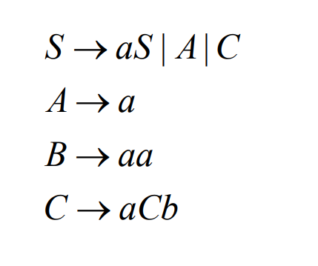
Ex#2:

Slide 14
Ex#3:
S -> AB/AC
A -> aAb/bAa/a
B -> bbA/aaB/AB
C -> abCA/aDb
D -> bD/aC
Eliminate Useless sybmols

Slide 15
Solution of EX#3
S -> AB
A -> aAb/bAa/a
B -> bbA/aaB/AB

Slide 16
Eliminating ε-productions
A => ε
Notes:
Cpt S 317: Spring 2009
School of EECS, WSU

Slide 17
Eliminating ε-productions
What’s the point of removing ε-productions?
A ➔ ε
: It is not possible to eliminate ε-productions for languages which include ε in their word set
Theorem: If G=(V,T,P,S) is a CFG for a language L, then L\ {ε} has a CFG without ε-productions
Definition: A is “nullable” if A➔* ε
If A is nullable, then any production of the form
“B➔ CAD” can be simulated by:
    B ➔ CD | CAD
      This can allow us to remove ε transitions for A
So we will target the grammar for the rest of the language
Notes:
Cpt S 317: Spring 2009
School of EECS, WSU

Slide 18
Algorithm to detect all nullable variables
Basis:
  If A➔ ε is a production in G, then A is nullable
  (note: A can still have other productions)
Induction:
  If there is a production B➔ C₁C₂…C_{k}, where every C_{i} is nullable, then B is also nullable
Notes:
Cpt S 317: Spring 2009
School of EECS, WSU

Slide 19
Eliminating ε-productions
Given: G=(V,T,P,S)
Algorithm:
  Detect all nullable variables in G
  Then construct G₁=(V,T,P₁,S) as follows:
    For each production of the form: A➔X₁X₂…X_{k}, where k≥1, suppose m out of the k X_{i}’s are nullable symbols
    Then G₁ will have 2^{m} versions for this production
      i.e, all combinations where each X_{i} is either present or absent
    Alternatively, if a production is of the form: A➔ε, then remove it
Notes:
Cpt S 317: Spring 2009
School of EECS, WSU

Slide 20
Example: Eliminating ε-productions
Let L be the language represented by the following CFG G:
  S➔AB
  A➔aAA | ε
  B➔bBB | ε
Goal: To construct G1, which is the grammar for L-{ε}
Nullable symbols: {A, B}
G₁ can be constructed from G as follows:
  B ➔ b | bB | bB | bBB
    ==> B ➔ b | bB | bBB
  Similarly, A ➔ a | aA | aAA
  Similarly, S ➔ A | B | AB
Note: L(G) = L(G₁) U {ε}
Simplified
grammar
G₁:
S ➔ A | B | AB
A ➔ a | aA | aAA
B ➔ b | bB | bBB
+
S ➔ ε
Notes:
Cpt S 317: Spring 2009
School of EECS, WSU

Slide 21
Practice questions
EX#1
Cases to Remove Null Productions
Case 01: If the Null (epsilon) move is the part of each string which derived from given CFG, then Null move cannot remove from that CFG.
Example
Consider a Context free grammar (G1) with the following production rules
S → aS | A
A → ε
After the simplification the grammar will be as: S → aS | a | ε

Slide 22
Case 02: And If the Null (epsilon) move is not the part of each string which derived from given CFG, then Null move can be removed from that CFG.
S → ABC
A → aA | ε
B→ bB | ε
C → c

Slide 23
Solution of CASE 2
S → ABC | BC | AC | C
A → aA | a
B→ bB | b
C → c

Slide 24
Ex#2
S -> AB
A -> aAA/ε
B -> bBB/ε
Remove Null Production from the CFG

Slide 25
Solution of EX#2
S -> AB/A/B/ε
A -> aAA/aA/a
B -> bAA/bA/b

Slide 26
Ex#3
S -> ABCd
A -> BC
B -> bB | λ
C -> cC | λ

Slide 27
Solution of Ex#3
S -> ABCd | ABd | ACd | BCd | Ad | Bd |Cd | d A -> BC | B | C
B -> bB | b
C -> cC | c

Slide 28
Eliminating unit productions
A => B
B has to be a variable
What’s the point of removing unit transitions ?
Will save #substitutions
E.g.,
A=>B | …
B=>C | …
C=>D | …
D=>xxx | yyy | zzz
A=>xxx | yyy | zzz | …
B=> xxx | yyy | zzz | …
C=> xxx | yyy | zzz | …
D=>xxx | yyy | zzz
before
after
Notes:
Cpt S 317: Spring 2009
School of EECS, WSU

Slide 29
Eliminating unit productions
A ➔ B
Unit production is one which is of the form A➔ B, where both A & B are variables
E.g.,
    E ➔ T | E+T
    T ➔ F | T*F
    F ➔ I | (E)
    I ➔ a | b | Ia | Ib | I0 | I1
  How to eliminate unit productions?
    Replace E➔ T with E ➔ F | T*F
    Then, upon recursive application wherever there is a unit production:
      E➔ F | T*F | E+T (substituting for T)
      E➔ I | (E) | T*F| E+T (substituting for F)
      E➔ a | b | Ia | Ib | I0 | I1 | (E) | T*F | E+T (substituting for I)
      Now, E has no unit productions
    Similarly, eliminate for the remainder of the unit productions
Notes:
Cpt S 317: Spring 2009
School of EECS, WSU

Slide 30
The Unit Pair Algorithm: to remove unit productions
Suppose A➔B₁ ➔B₂ ➔ … ➔ B_{n} ➔ α
Action: Replace all intermediate productions to produce α directly
  i.e., A➔ α; B₁➔ α; … B_{n} ➔ α;
Definition: (A,B) to be a “unit pair” if A➔*B
We can find all unit pairs inductively:
  Basis: Every pair (A,A) is a unit pair (by definition). Similarly, if A➔B is a production, then (A,B) is a unit pair.
  Induction: If (A,B) and (B,C) are unit pairs, and A➔C is also a unit pair.
Notes:
Cpt S 317: Spring 2009
School of EECS, WSU

Slide 31
The Unit Pair Algorithm: to remove unit productions
Input: G=(V,T,P,S)
Goal: to build G₁=(V,T,P₁,S) devoid of unit productions
Algorithm:
Find all unit pairs in G
For each unit pair (A,B) in G:
    Add to P₁ a new production A➔α, for every B➔α which is a non-unit production
    If a resulting production is already there in P, then there is no need to add it.
Notes:
Cpt S 317: Spring 2009
School of EECS, WSU

Slide 32
Example: eliminating unit productions
Unit pairs | Only non-unit productions to be added to P₁
(E,E) | E ➔ E+T
(E,T) | E ➔ T*F
(E,F) | E ➔ (E)
(E,I) | E ➔ a|b|Ia | Ib | I0 | I1
(T,T) | T ➔ T*F
(T,F) | T ➔ (E)
(T,I) | T ➔ a|b| Ia | Ib | I0 | I1
(F,F) | F ➔ (E)
(F,I) | F ➔ a| b| Ia | Ib | I0 | I1
(I,I) | I ➔ a| b | Ia | Ib | I0 | I1
    G:
    E ➔ T | E+T
    T ➔ F | T*F
    F ➔ I | (E)
    I ➔ a | b | Ia | Ib | I0 | I1
    G₁:
    E ➔ E+T | T*F | (E) | a| b | Ia | Ib | I0 | I1
    T ➔ T*F | (E) | a| b | Ia | Ib | I0 | I1
    F ➔ (E) | a| b | Ia | Ib | I0 | I1
    I ➔ a | b | Ia | Ib | I0 | I1
Notes:
Cpt S 317: Spring 2009
School of EECS, WSU

Slide 33
Putting all this together…
Theorem: If G is a CFG for a language that contains at least one string other than ε, then there is another CFG G₁, such that L(G₁)=L(G) - ε, and G₁ has:
  no ε -productions
  no unit productions
  no useless symbols
Algorithm:
  Step 1) eliminate ε -productions
  Step 2) eliminate unit productions
  Step 3) eliminate useless symbols
Again,
the order is
important!
Why?
Notes:
Cpt S 317: Spring 2009
School of EECS, WSU

Slide 34
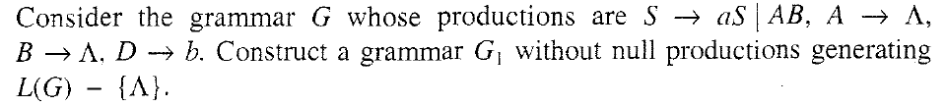
PROBLEM
Notes:
Cpt S 317: Spring 2009
School of EECS, WSU
PROBLEM

Slide 35
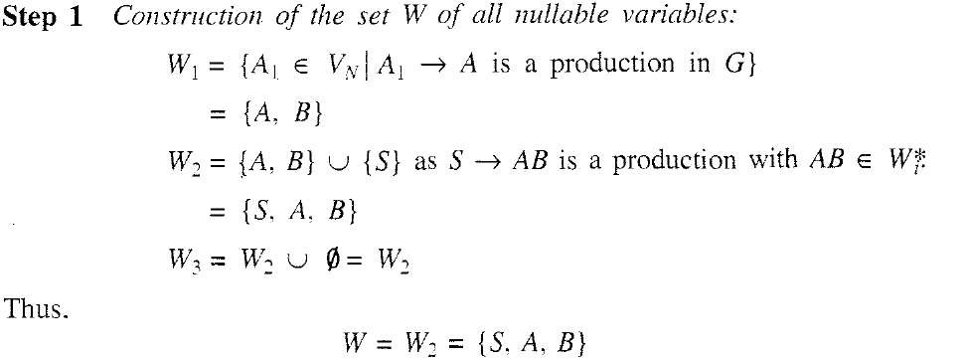
SOLUTION
Notes:
Cpt S 317: Spring 2009
School of EECS, WSU
SOLUTION

Slide 36
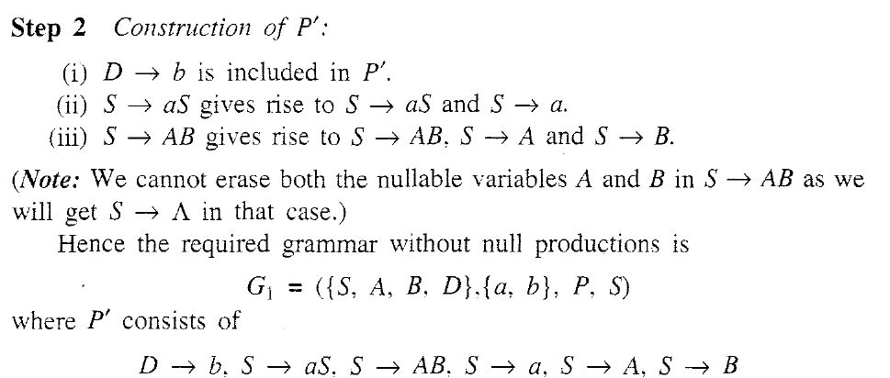
SOLUTION
Notes:
Cpt S 317: Spring 2009
School of EECS, WSU
SOLUTION

Slide 37
Ex#2
S -> Aa/B/c
B -> A/bb
A -> a/bc/B
Remove the Unit Production from the CFG

Slide 38
Solution of Ex#2
S -> Aa/c/bb/a/bc
B -> bb/a/bc
A -> a/bc/bb

Slide 39
Ex#3
S -> AC
A -> a
C -> B/d
B -> D
D -> E
E -> b
Simplify the Grammar

Slide 40
Solution of Ex#3
S -> AC
A -> a
C -> d/b
B -> b
D -> b
E -> b
After removing useless symbols it will be as:
S -> AC A -> a C -> d/b

Slide 41
Ex#4
Simplify the following CFG
1. S -> XaX/bX
X-> XaX/XbX/ Ꜫ
2. I-> a/b/Ia/Ib/I0/I1
F-> I/(E)
T->F/T*F
E->T/E+T

